Slide 1


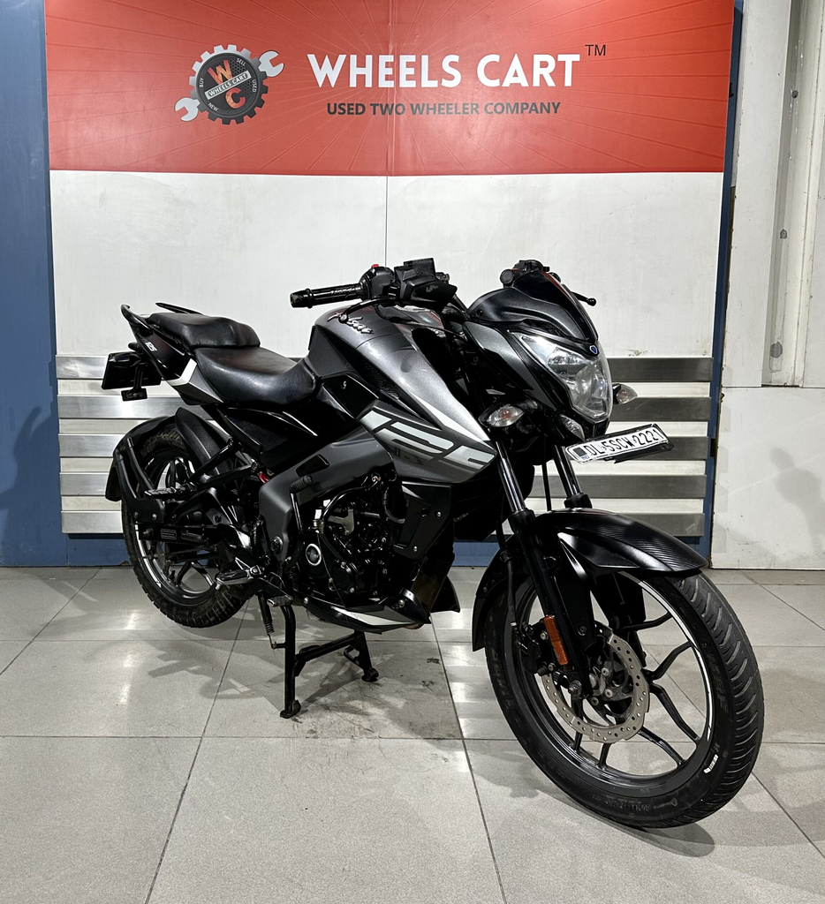

AMRUTA INSTITUTE OF ENGINEERING AND MANAGEMENT SCIENCES
DEPARTMENT OF INFORMATION SCIENCE AND ENGINEERING
MINI PROJECT REVIEW
BIKE PREFERENCE SURVEY
The survey which is taken from people from different age group for determining the preference of choosing their bike under several specifications like age , type of vehicles , mileage etc..
Presented by Simon Leo Alexander
1AR23IS042

Slide 2
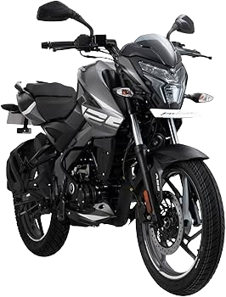
OBJECTIVE OF THE SURVEY
THE PROBLEM STATEMENT
Understand the bike preferences of young adults.
Identify key factors influencing bike purchase decisions.
Analyze demographic patterns (age, gender) in preferences.
Provide insights for marketing, product development, and future trends.

Slide 3
DATASET OVERVIEW
Total Responses: 80
Columns analyzed: Age Group, Gender, Bike Ownership, Preferred Bike Type, Brand Preference, Purchase Factors, Purpose of Usage
Data Cleaning:
Removed identifying information (Name, Email, Timestamp)
Categorical data analyzed with count plots and cross-tabulations
Numeric data not present; focus on frequencies and preferences
Caption: “Dataset primarily consists of categorical responses from respondents.”

Slide 4
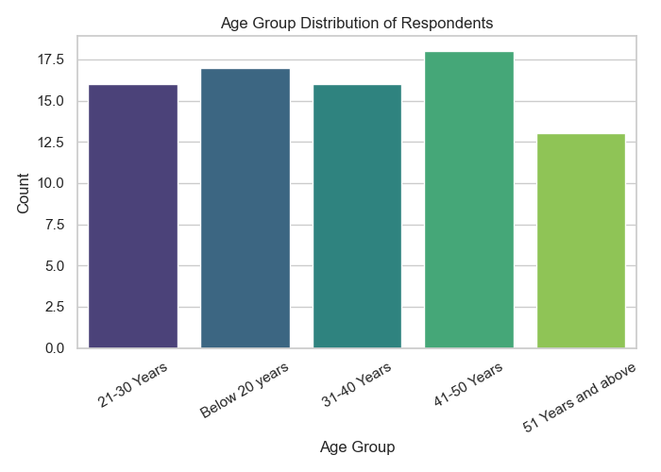
DEMOGRAPHICS: AGE DISTRIBUTION
The graph of the maximum people responded based on their age
All the responses are almost equal.
Implies that the survey is conducted within many age groups.

Slide 5
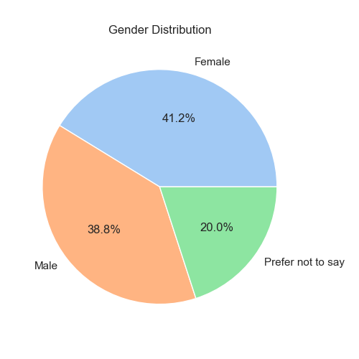
DEMOGRAPHICS: GENDER DISTRIBUTION
Pie chart showing the responses based on gender
This chart shows the percentage of males and females who filled the survey form.
Here according to the data the maximum people who filled the form is female people.

Slide 6
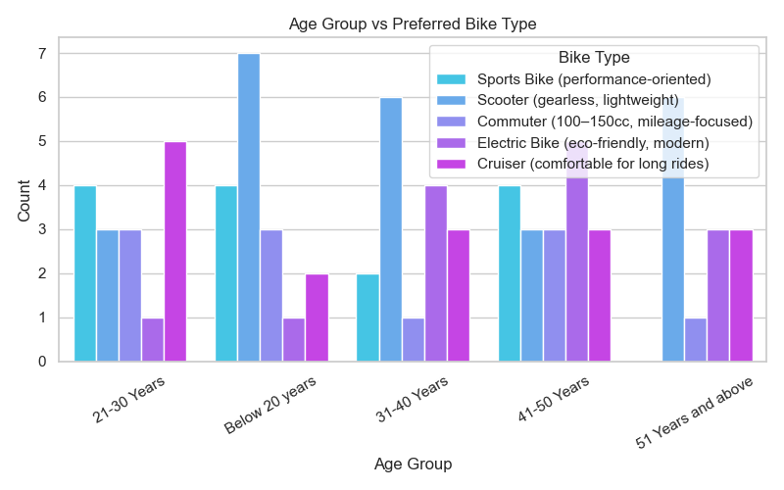
AGE GROUP VS PREFERED BIKE TYPES
This graph shows the data in which there are preferences of people of different age groups and the type of bikes they prefer
In this Graph there are age groups and the type of bikes and the graph shows the most preferred type of bike chosen by different people

Slide 7
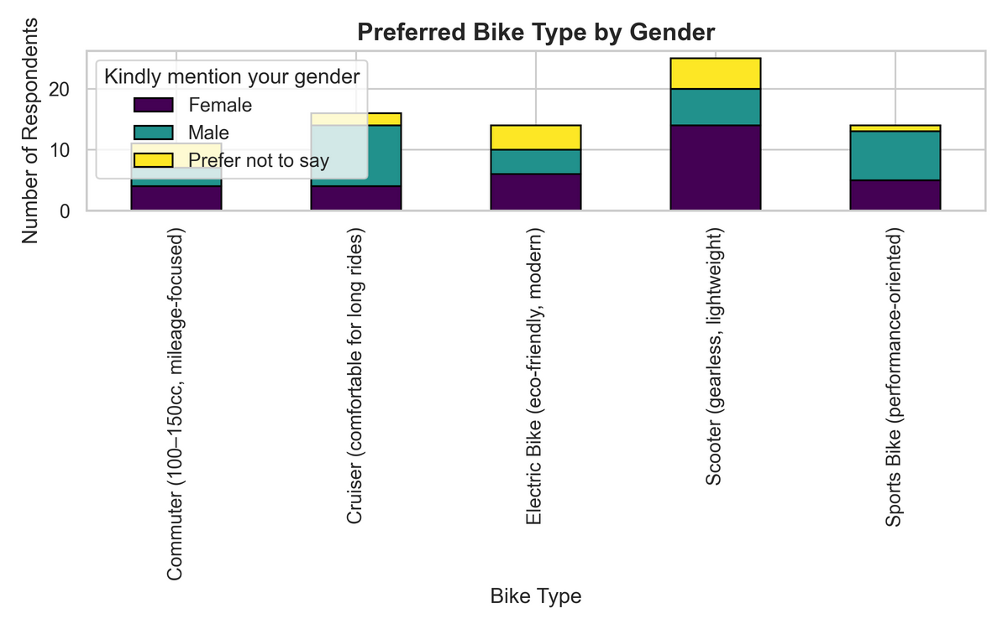
PREFERRED BIKE TYPE BY GENDER
The Preferred bike type with respect to GENDER
This is the graph which shows the preferred type of bike with respect to the gender of the person who took part in the survey

Slide 8
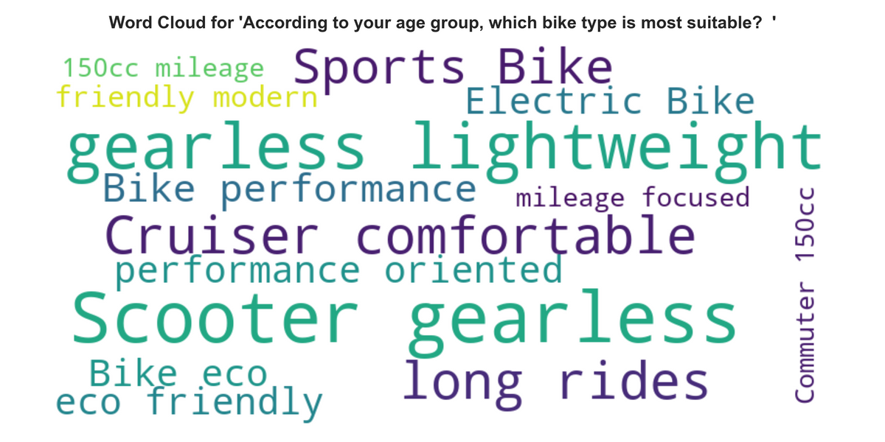
WORD CLOUD OF OPEN-ENDED RESPONSES
The word count for suitable bikes with respect to age groups
In this graph there is the count of words for most suitable bike for respective age group the larger the word the larger the suitability

Slide 9
KEY FINDINGS & CONCLUSION
Majority respondents are 21–30 years old and predominantly male.
Popular bike types: commuter and electric bikes.
Price sensitivity: Mid-range bikes preferred (₹70,000–₹1,00,000 approx.).
Top purchase factors: Mileage, Comfort, Brand Reputation.
Gender & age influence bike type choice — valuable for segmentation.
Purpose of usage mostly for daily commute, followed by leisure.

Slide 10
FUTURE SCOPE / RECOMMENDATIONS
Target marketing campaigns based on age and gender preferences.
Focus on mid-range commuter and electric bikes for young adults.
Highlight mileage, comfort, and brand reputation in advertisements.
Consider environmental awareness campaigns to boost EV adoption.
Use survey insights for product development, features, and pricing strategy.

Slide 11
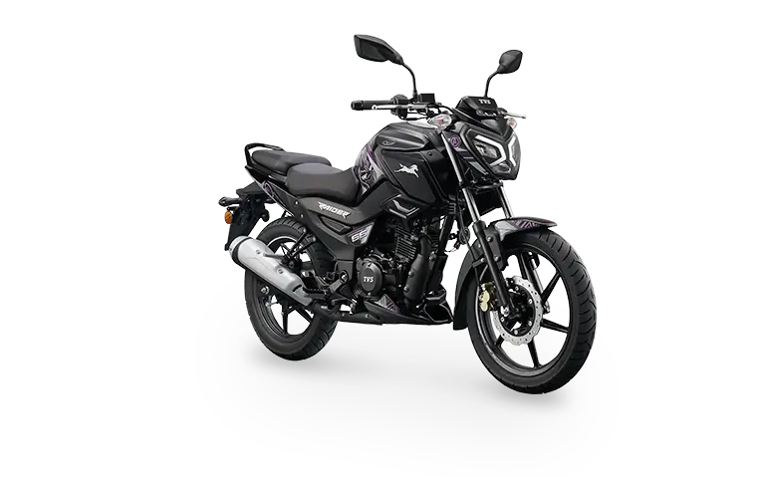
THANK YOU

